Slide 1

Individual-based models & Spatially explicit individual-based models with NetLogoR
21-22 Juin 2021
Sarah Bauduin - Chargée de recherche à l’OFB
Équipe Loup-Lynx, Unité Prédateurs Animaux Déprédateurs et Exotiques

Slide 2


Workshop
6 sessions
Day 1 / Day 2
9h-10h30
10h45-12h
14h-16h

Slide 3
Goals of this workshop
Day 1
Getting familiar with individual-based models (IBMs)
Getting familiar with NetLogoR
Understanding simple models coded in NetLogoR
Day 2
Understanding more complex models coded in NetLogoR
Debugging IBMs
Parameterizing IBMs
Publishing IBMs
Coding on your own

Slide 4
Individual-based models (IBM)

Slide 5
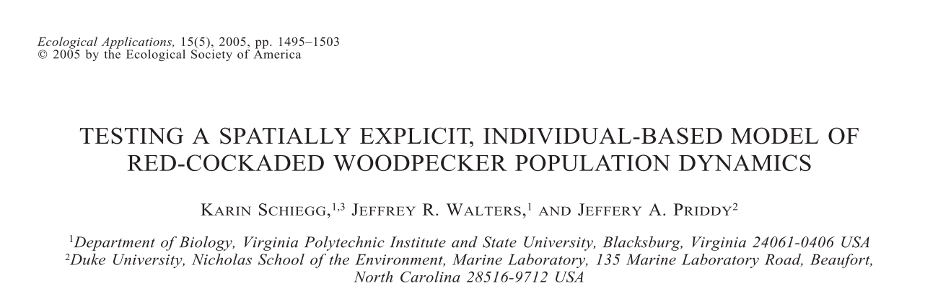
Study example using IBM:
Predict population size, number of territories, population structure, dispersal success, natal dispersal distances, and age distributions for the Red-cockaded Woodpecker

Slide 6
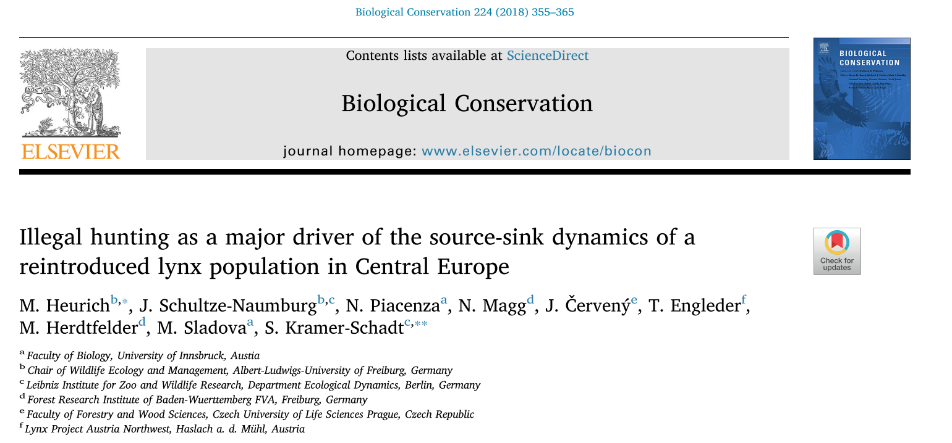
Study example using IBM:
Estimate illegal hunting for the Lynx

Slide 7
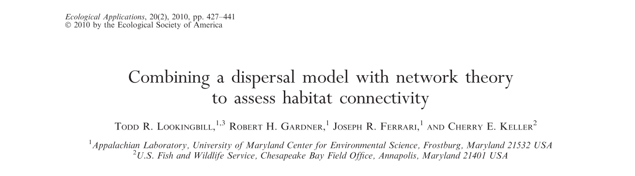
Study example using IBM:
Simulate dispersal patterns and estimate functional connectivity for the Delmarva fox squirrel

Slide 8
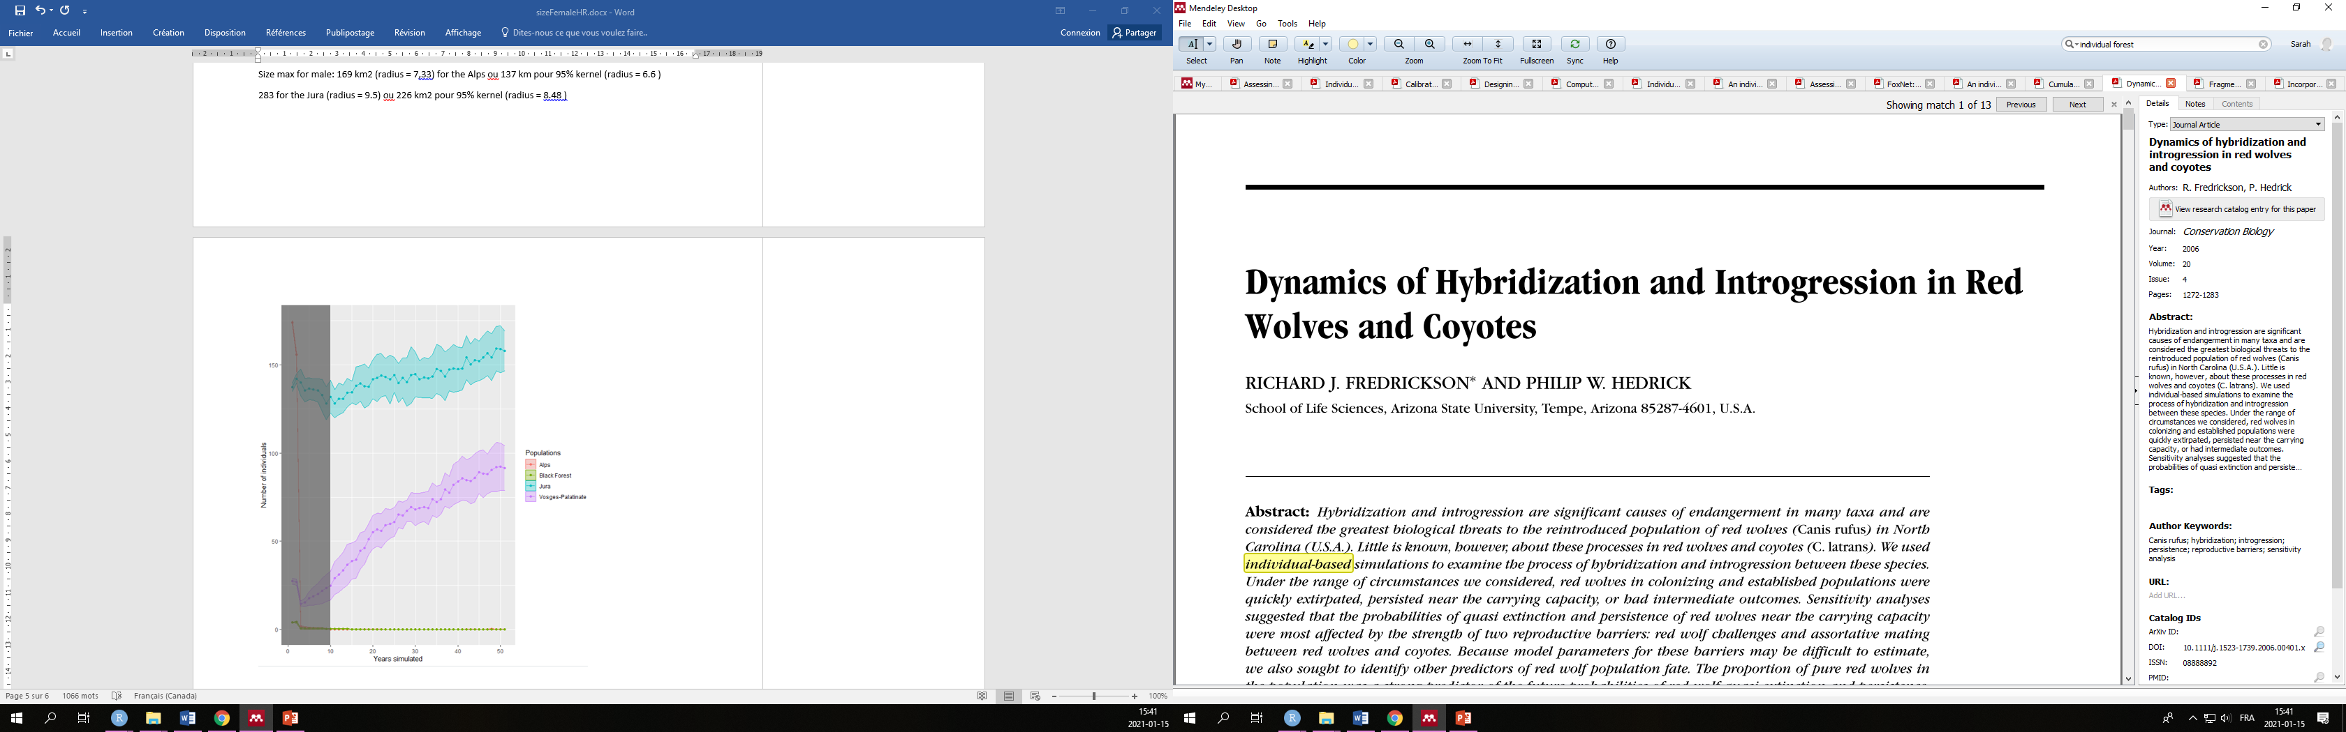
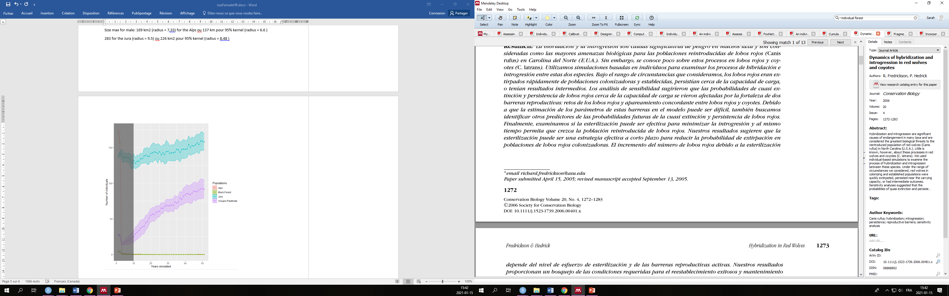
Study example using IBM:
Examine the process of hybridization and introgression between the Red wolf and the coyotes

Slide 9
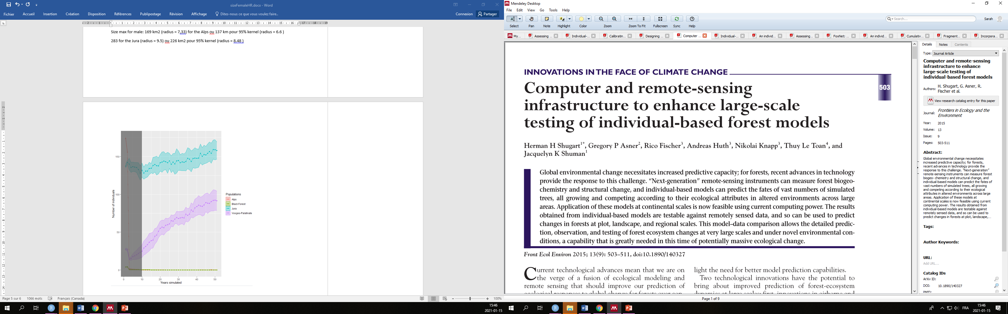
Study example using IBM:
Simulate regional change in forest structure under different management and disturbance regimes

Slide 10
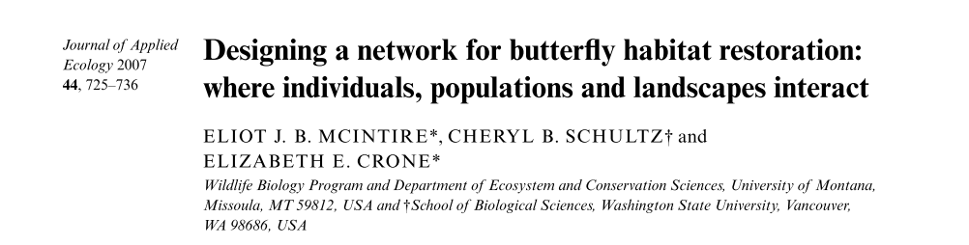
Study example using IBM:
Assess the ability of potential restored landscapes to create persistent and connected populations of the federally endangered Fender’s blue butterfly

Slide 11
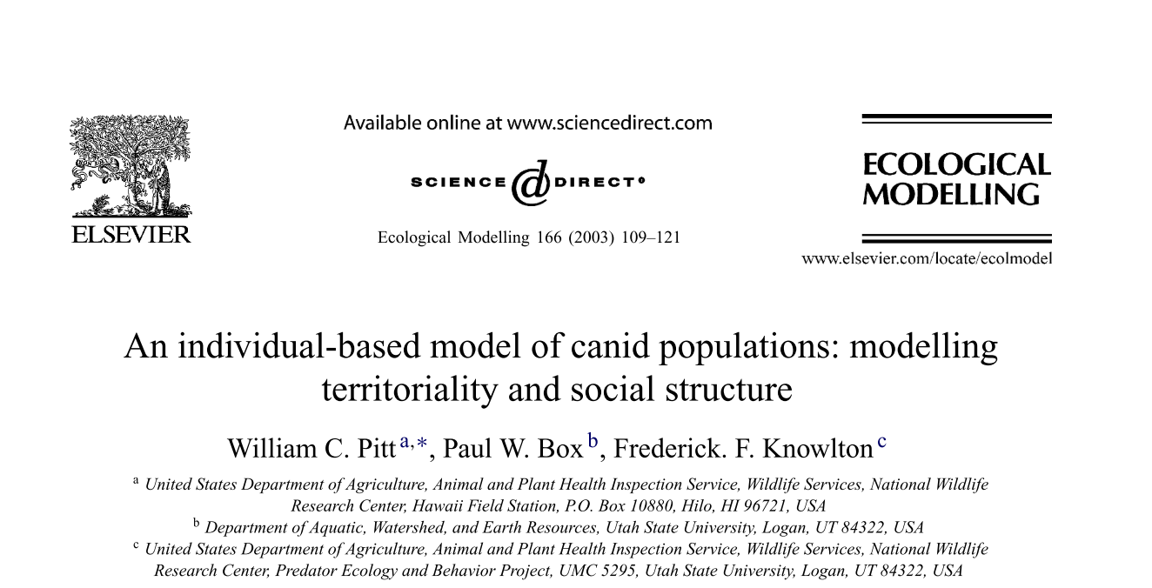
Study example using IBM:
Understand the effect of social structure and territoriality on canid populations

Slide 12
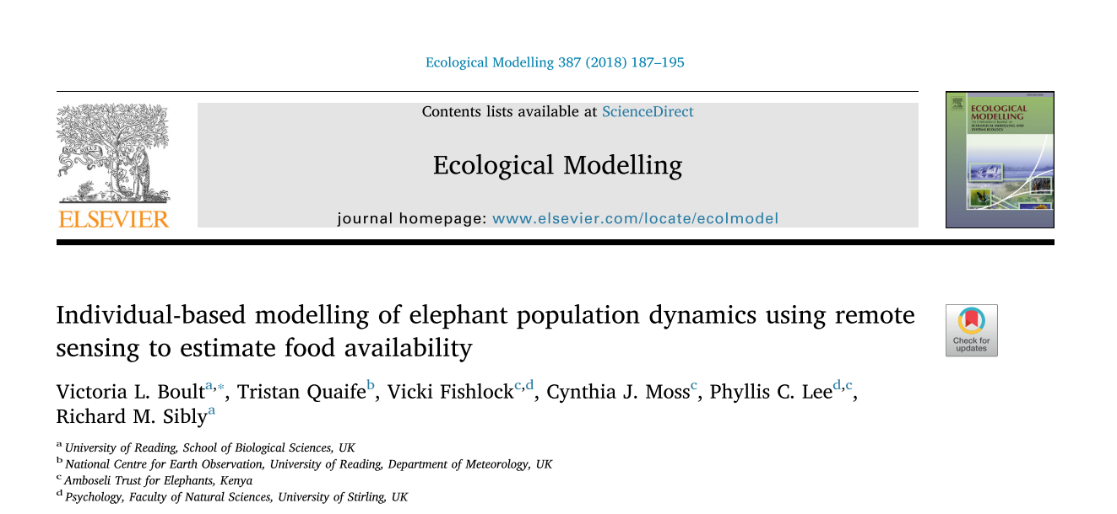
Study example using IBM:
Model the energy budget for the African elephant to relate remotely measured changes in food availability to vital demographic rates of birth and mortality

Slide 13
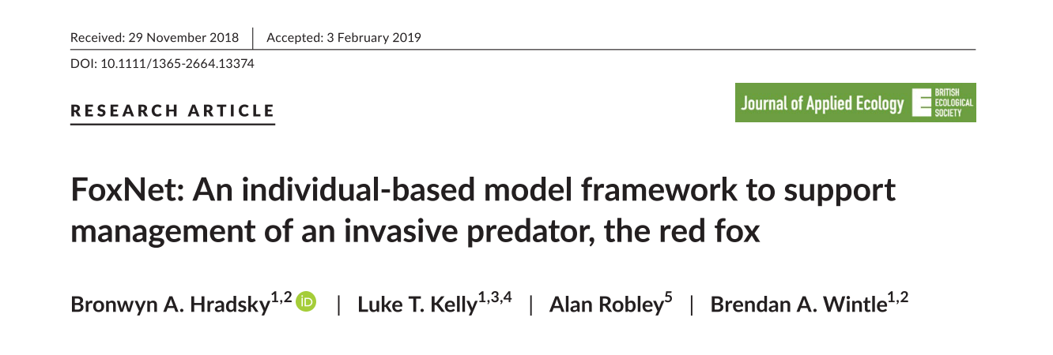
Study example using IBM:
Predict red fox population dynamics including responses to control and landscape productivity

Slide 14
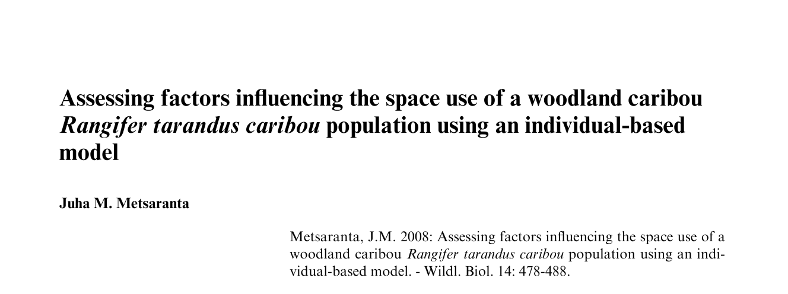
Study example using IBM:
Estimate the importance of different forest types and home-range fidelity in the space use of the woodland caribou

Slide 15
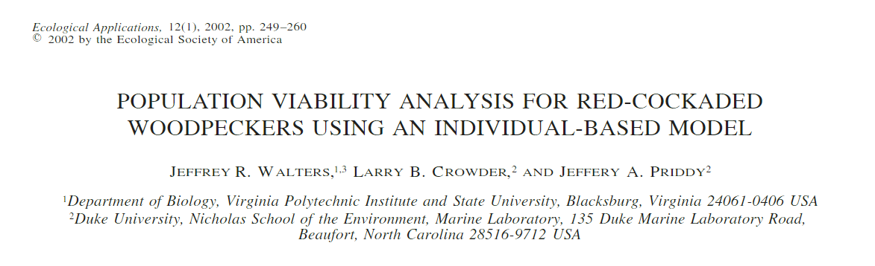
Study example using IBM:
Assess the vulnerability of Red-cockaded Woodpecker populations to demographic and environmental stochasticity (PVA)

Slide 16
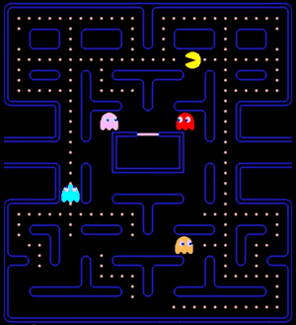
IBM example:

Slide 17
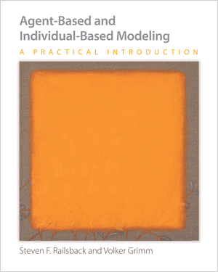
Individual-Based Models
IBMs are simulation models
Bottom-up
Rules at the individual level
Unique and autonomous entities
Interactions between individuals
Adaptive behavior
Outputs at the population level
Spatially Explicit IBMs (SE-IBMs)
Influence/Interactions with the environment
Highly mechanistic
Based on causes and effects
Understanding of the processes
Used to make predictions
Railsback and Grimm, 2012

Slide 18
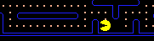
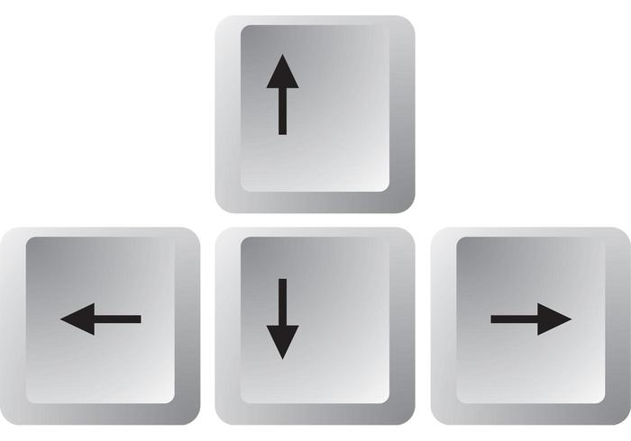
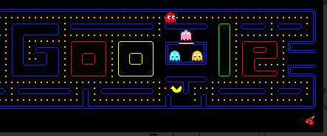
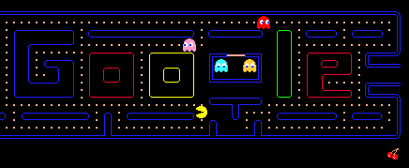

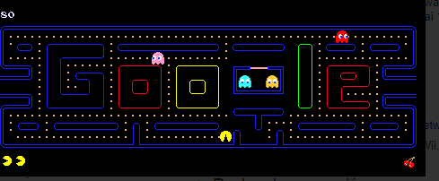
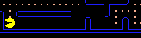
Game control = model

Slide 19
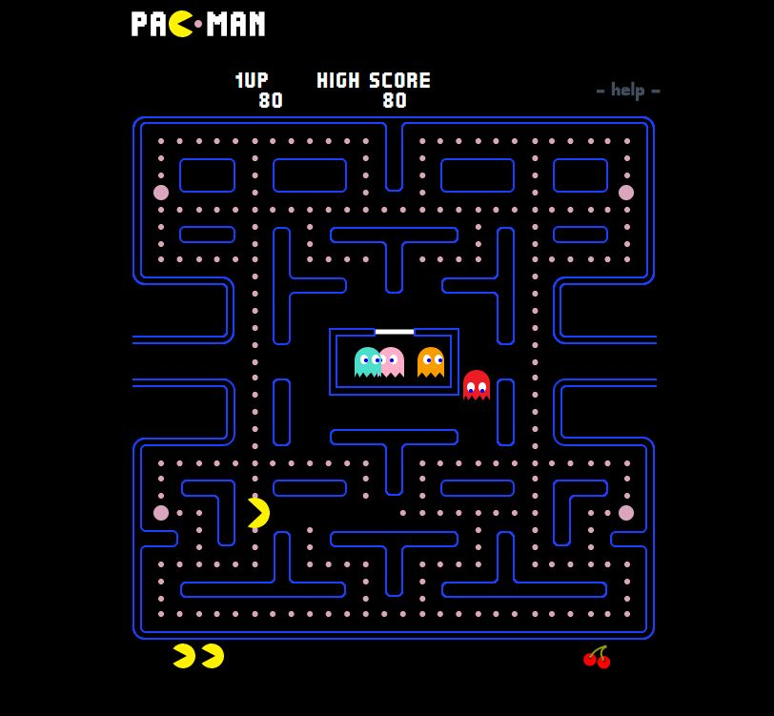
Pacman is a SE-IBM!
Repeat
Pacman
*
Habitat
MOVEMENT
Possible directions
Directions with dots
None => choose one randomly
Just one => choose this one
Several => choose one randomly
Rotate
Move
* without the ghosts

Slide 20
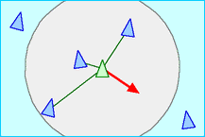
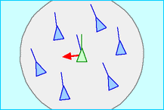
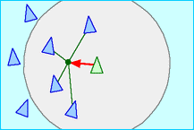
Bird flocking
Reproducing population patterns from very simple individual rules
E.g., bird flocks, fish schools
Bird flight – 3 simple rules
Separation: steer to avoid crowding local flockmates
Alignment: steer towards the average heading of local flockmates
Cohesion: steer to move toward the average position of local flockmates
Creation of bird flock
Reynolds, 1986

Slide 21


Slide 22
References
Individual-based models
Grimm V, Railsback SF. 2005. Individual-based modeling and ecology. Princeton University Press, Princeton, NJ.
Railsback SF, Grimm V. 2012. Agent-based and individual-based modeling: a practical introduction. Princeton University Press, Princeton, NJ.
Reynolds. 1986. https://www.red3d.com/cwr/boids/
Bauduin S, Grente O, Santostasi NL, Ciucci P, Duchamp C, Gimenez O. 2020. An individual-based model to explore the impacts of lesser-known social dynamics on wolf populations. Ecological Modelling 433:109209.
van Vliet K, Hofstede GJ. 2019. Wolves ODD.

